Slide 1






presented in VSCode
BANK
OF
CLI
By: Monzerrat Mejia-Mendoza

Slide 2



Quick Overview On What Is In Project Bank_of_CLI:
The Tech Stack Used:
Language: Java
Build Tool: Maven
Database: Postgres
Testing: JUnit 5
Verison Control:Git & GitHub
Multilayered Architecture:
API Layer -> Service Layer -> Persistence Layer -> PostgreSQL
Object-Oriented Design:
Abstraction, Encapsulation, Inheritance, Polymorphism, singleton pattern & composition

Slide 3



JAVA
is a general purpose, object-oriented , statically typed language that runs on the JVM
how its used:
why it fits:
each layer is in plain Java. For ex: interfaces, classes, a custom BankExeception and I/O for the CLI
strong typing and first class OOP fit a layered design and its the required stack

Slide 4


MAVEN
a build and dependency manager configured through a single pom.xml
how its used:
why it fits:
pulls in the postgreSQL database and Junit5, enforces the standard src/main and src/test layout and runs the suite w/mvn test
well anyone can clone the repo and build it the same way, with NO downloaded jars (assuming they also used a Docker container as well)

Slide 5


JUNIT 5
W/MOCKITO
Java’s standard unit-testing framework
how its used:
why it fits:
uses JUnit along w/Mockito to meaningfully validating application behavior through positive tests, it confirms valid deposits update the DAO and negative tests which ensures negative amounts throw an exception w/out invoking the database
it requires strict accuracy and ensure the core financial logic works well w/out needing a live database

Slide 6

POSTGRES
an open-source relational database w/full ACID transactions
how its used:
why it fits:
holds the account & transaction tables w/foreign keys and NUMERIC(12, 2) for money. hosted on a Docker container
ACUD guarantees to keep balances consistent and NUMERIC avoids floating-points rounding errors

Slide 7




GIT & GITHUB
Git tracks EVERY change in code while GitHub hosts the repo
how its used:
why it fits:
the Bank_of_CLI repo holds the source, the tests, a README w/the setup steps and the SQL for the tables
the fully history, safe backups and a super easy way to share the project to anyone!

Slide 8

multi-layered architecture
Service layer
PostgreSQL
API layer
Persistence layer
terminal menu:
register, login, balance, deposit, withdraw, transfer & history it reads user input (aka Scanner) and prints results
validate business rules:
amount ALWAYS positive, no transferring to yourself and checks pin to login
runs on SQL, manages transactions/rollbacks for atomicty, converts ResultSet rows into account/transaction obejcts
stores account/transaction tables, enforces balance >= 0 at the database level via a CHECK constraint

Slide 9


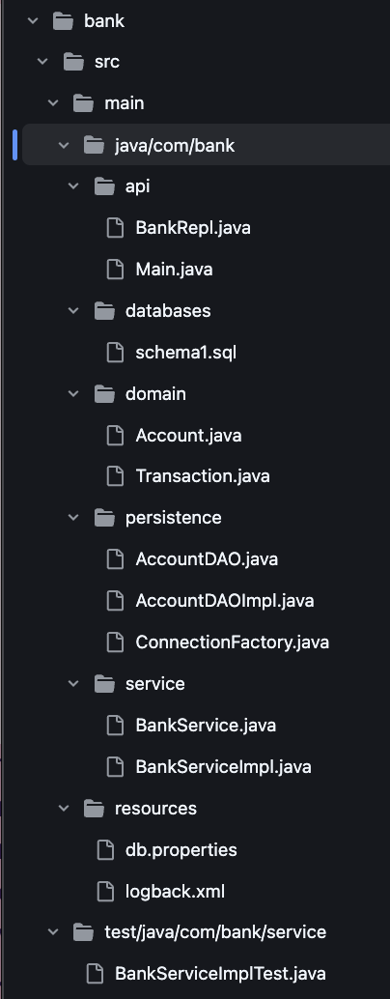

Slide 10

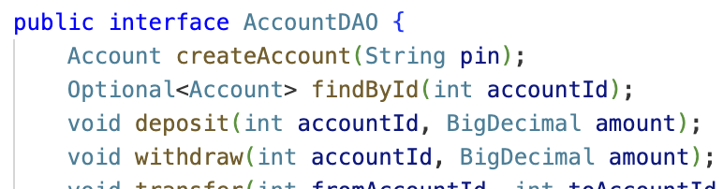

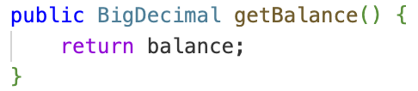
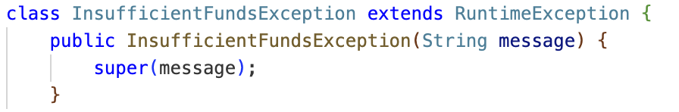
object oriented design
abstraction:
callers depend on what a class does, not how it does it. BankServiceImpl calls this interface, but it never sees SQL/Connection objects
encapsulation:
interal state is private, only controlled access is exposed. Nothing outside Account can directly overwrite balance, but changes only happen through DAO methods, backed by the database’s CHECK constraint
inheritance:
a specialized class extends a general one. this custom exception exetnds RuntimeException to signal a specific business failure (overdraft) distinct from a gernal error

Slide 11

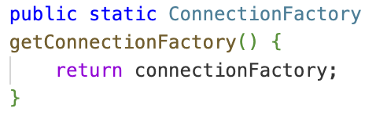
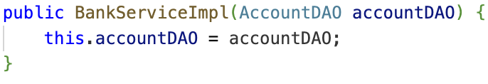
continued….
polymorphism:
code only works w/the interface type, the real implementation is swapped in at runtime. this variable’s declared type is the interface, NOT the concrete class. A different implementation could be subsuited w/out changing the line
singleton pattern:
exactly one instance exists, shared everywhere its needed. One ConnectionFactory instance manages the database connection config for the entire thing, never re instantiated per call
composition:
a class is built from other objects, rather than inheriting from them. BankServiceImpl has a AccountDAO, which are objects are combined (service holds a DAO, REPL holds a service) rather than extended through a class hierarchy

Slide 12
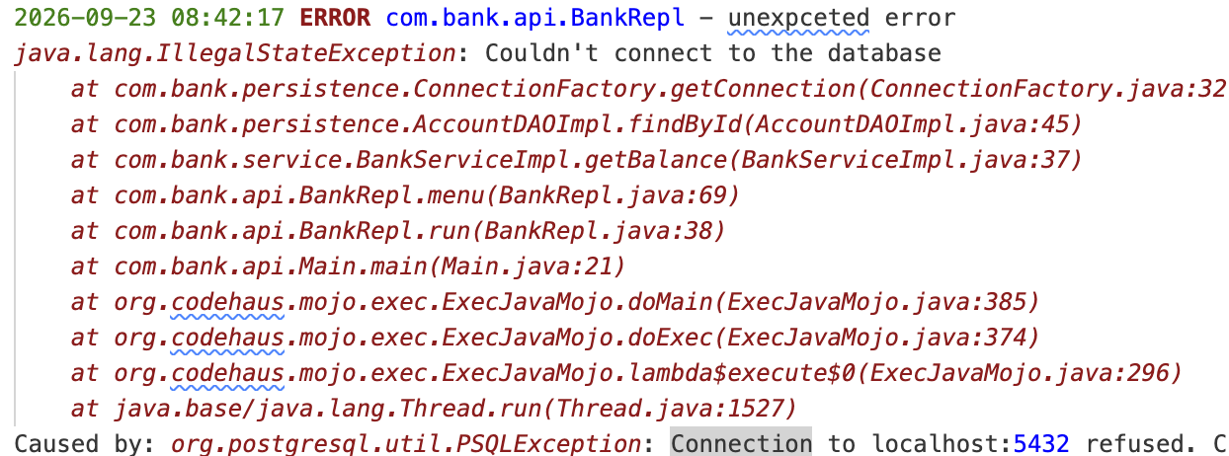

logging & testing:
SLF4J + logback
this snippet shows how i had a real failure caught during testing. The database container was running but the problem was, i was in the wrong directory. so instead of crashing, i received this message
SLF4J (simple logging facade for java) is the interface the code calls.
Logback is the implementation that formats and writes it to the bank.log
ERROR
INFO
logs a successful business action (like the completed deposit) written by the service layer

Slide 13
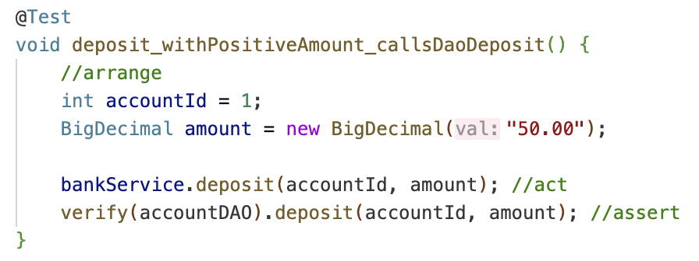
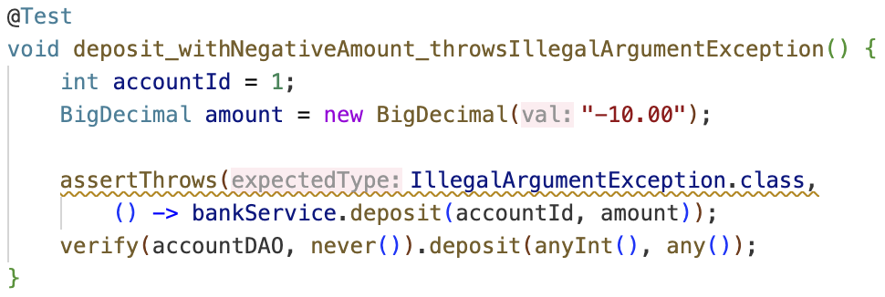
continued…
testing (JUnit + mockito)
Positive test: confirms a valid deposit is passed through to the DAO correctly
JUnit 5 runs the tests
Mockito mocks the DAO so service layer logic is tested w/out a live database connection
negative test: confirms a negative amount is rejected before the DAO is ever called

Slide 14
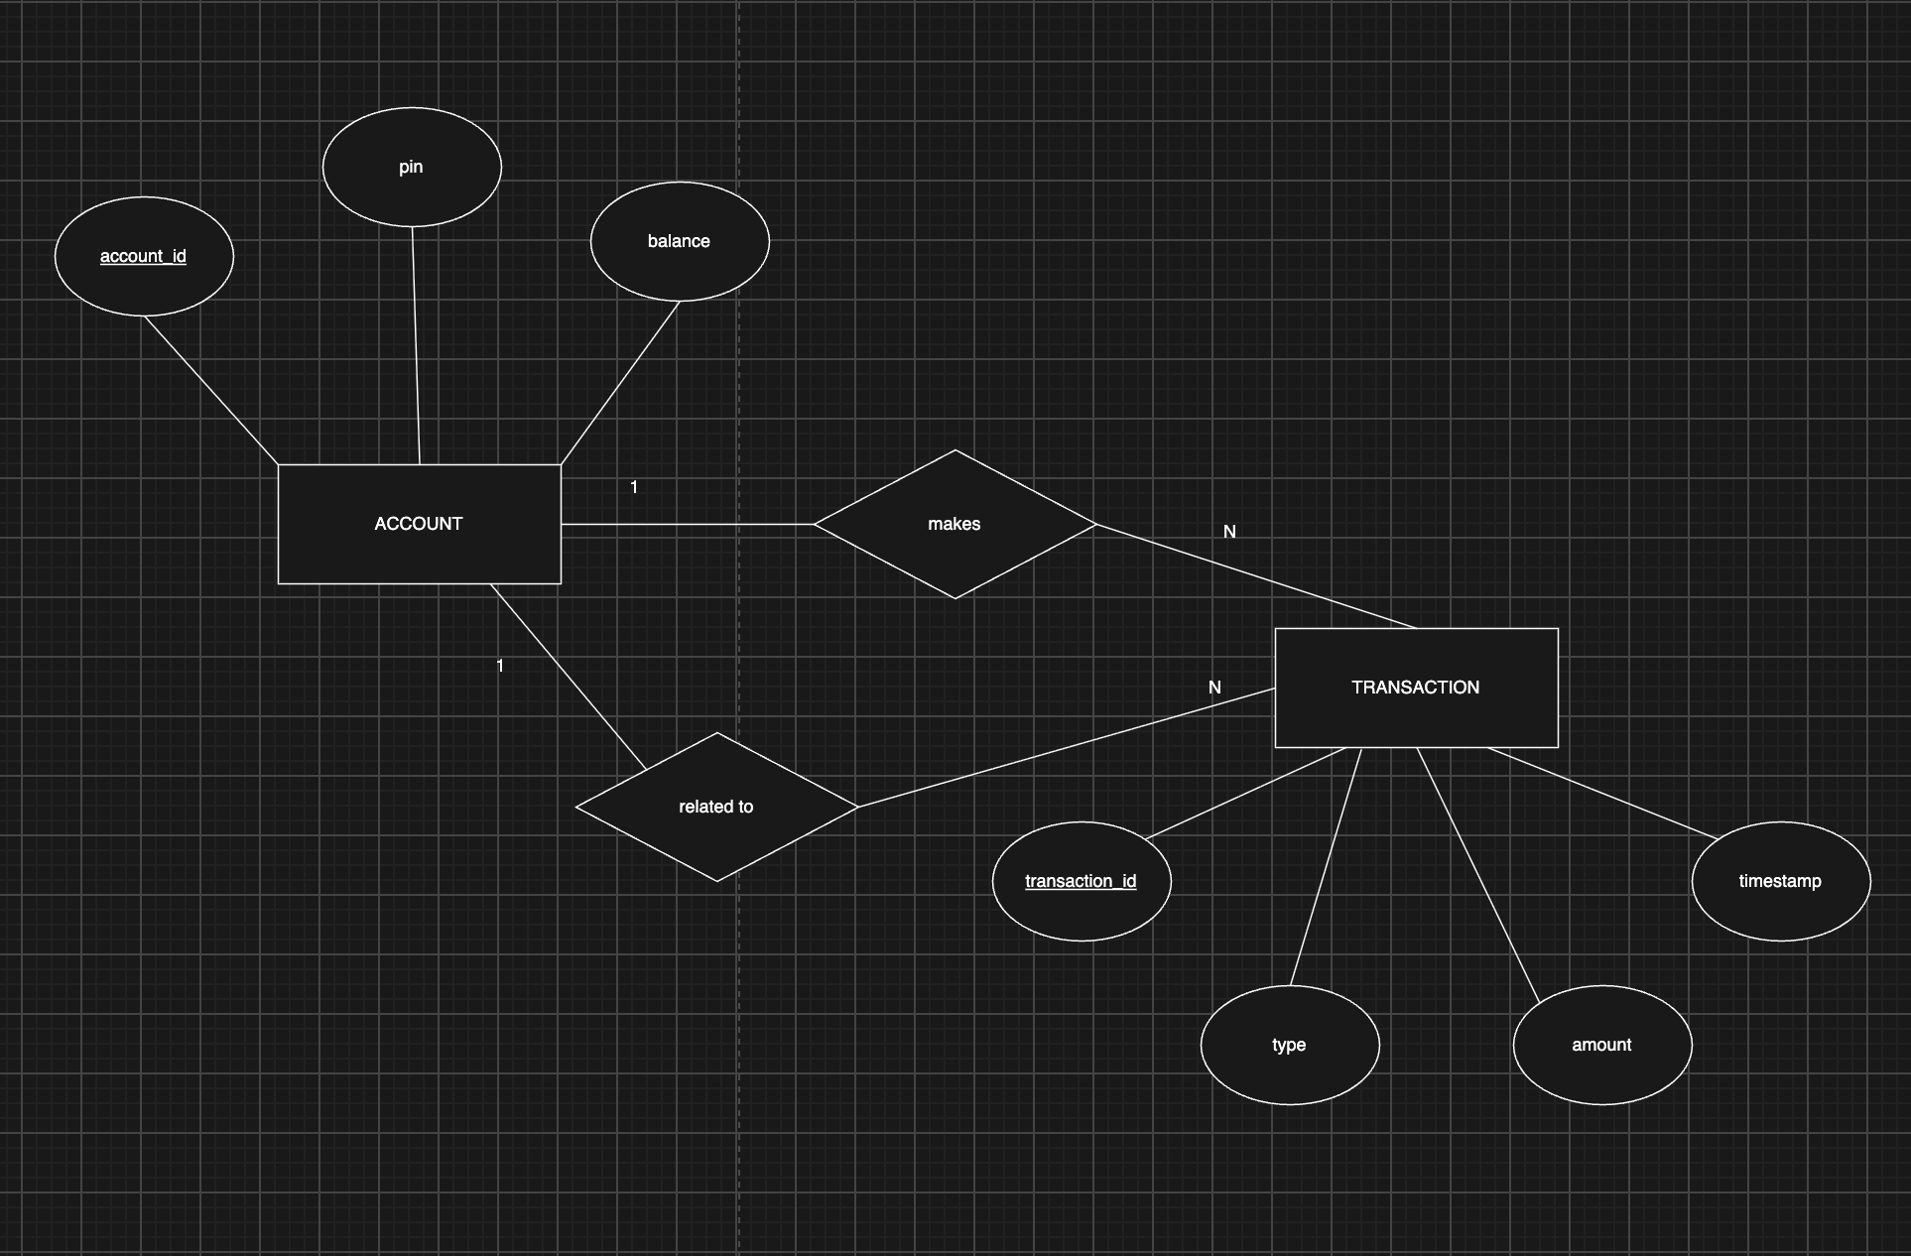
ERD:

Slide 15
Thank
You!

